Slide 1

Block-chain based advanced ERP System
AADITYA M NAIR
MCA S4-A

Slide 2
Contents
Relevance of Topic
Project Description
Objectives of Study
Existing System and Proposed System
Modules identified
Input / Output code Description
UI Design and Implementation Details

Slide 3
Relevance of Topic
Why do you need an advanced ERP system in 2022?
Better business performance.
Growth of business.
Improved response time.
Faster decision making.
Better than legacy system.

Slide 4
Project Description
An Enterprise Resource Planning (ERP) system is a software that helps business organization to standardize different process.
Procurement
Employee Management
Project Management
ERP SYSTEM

Slide 5
Integrating ERP with Block-chain
Block chain technology is a technology that uses decentralized ledgers to keep transaction records.
Thereby it provides:
Security
Transparency
No middle-men in transaction

Slide 6
Objectives of Study
To integrate blockchain with ERP :
To provide better transparency and security to data.
To determine methods that could effectively manage business activities.

Slide 7
Existing System and Proposed System
Existing System
Proposed System
Centralized System
Lack of transparency
More chance of manipulation
Decentralized
Ensure transparency
No manipulation

Slide 8
Modules identified
The different modules identified are :
Employee Management
Employee Registration
Procurement
Purchase
Stock
Project Management
Add project
Manage project

Slide 9
Algorithm
SSH Algorithm
SSH – Secure Shell
Used for encryption and transfer data securely over insecure network.
Only admin can decrypt using his secret key and view.

Slide 10
Input / Output code Description
Code to manage approval of each blockchain admins.
Code to encrypt the ledger.
Code to generate blocks.

Slide 11
UI Design and Implementation Details
Django
Django is a free and open-source, python-based web framework that follows the model–template–views architectural pattern.
PyCharm
PyCharm is an integrated development environment used in computer programming, specifically for the Python programming language.
It is developed by the company JetBrains.
HTML/CSS

Slide 12
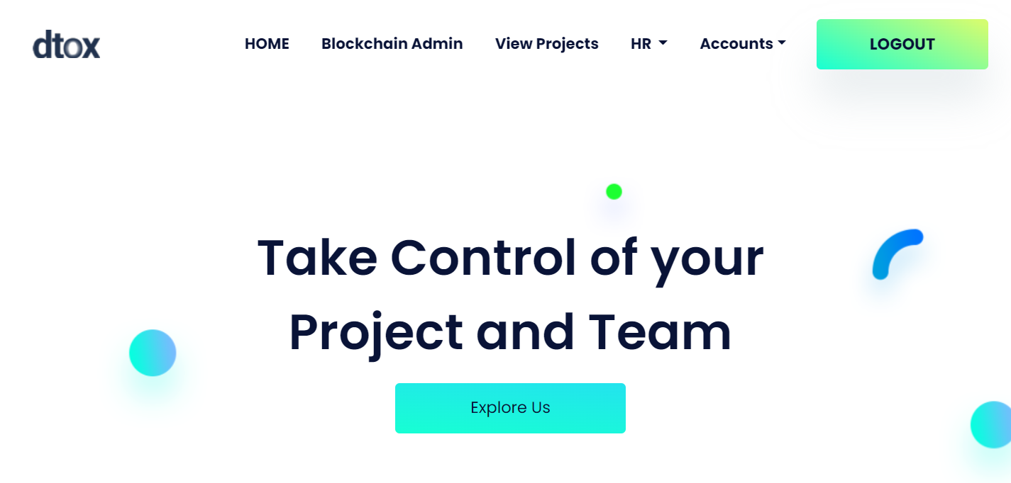
Sample Screenshots
1. ADMIN
Home Page

Slide 13
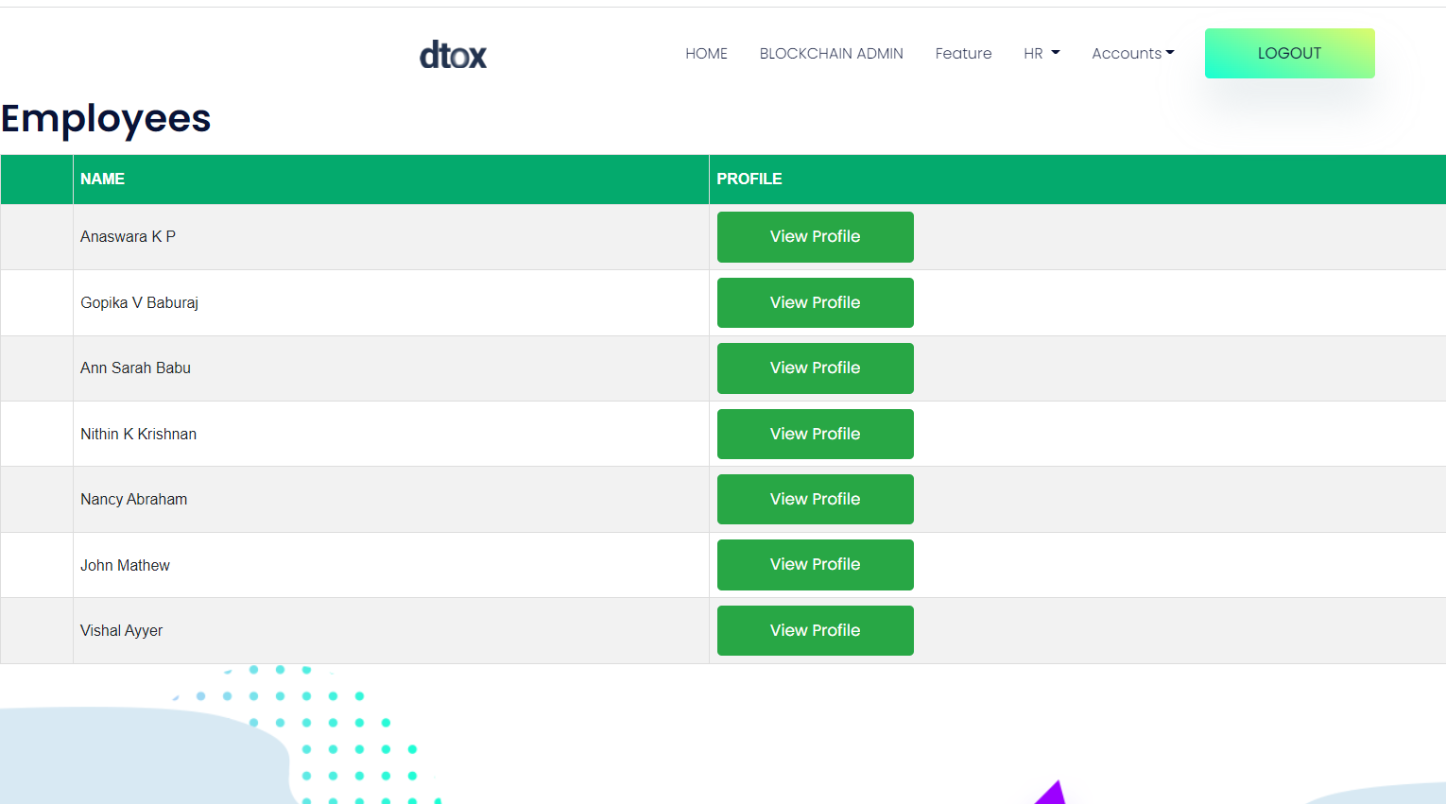
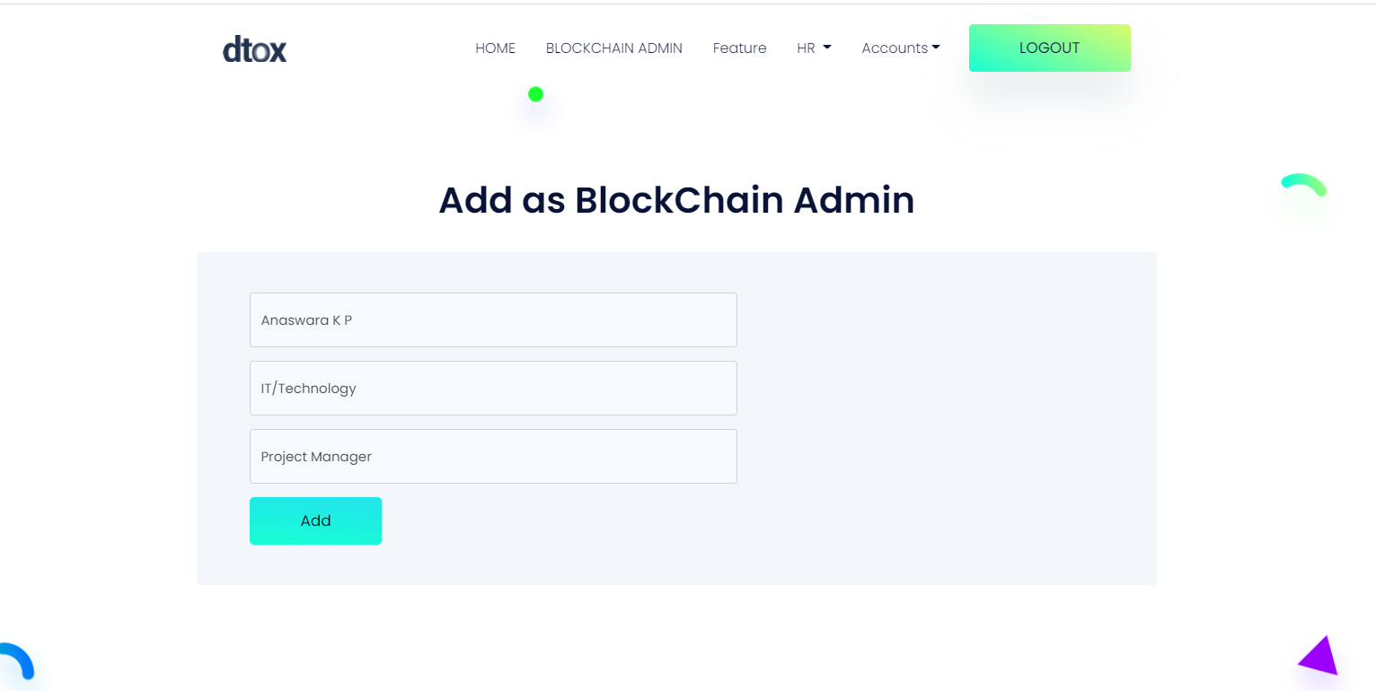
Add Blockchain admin

Slide 14
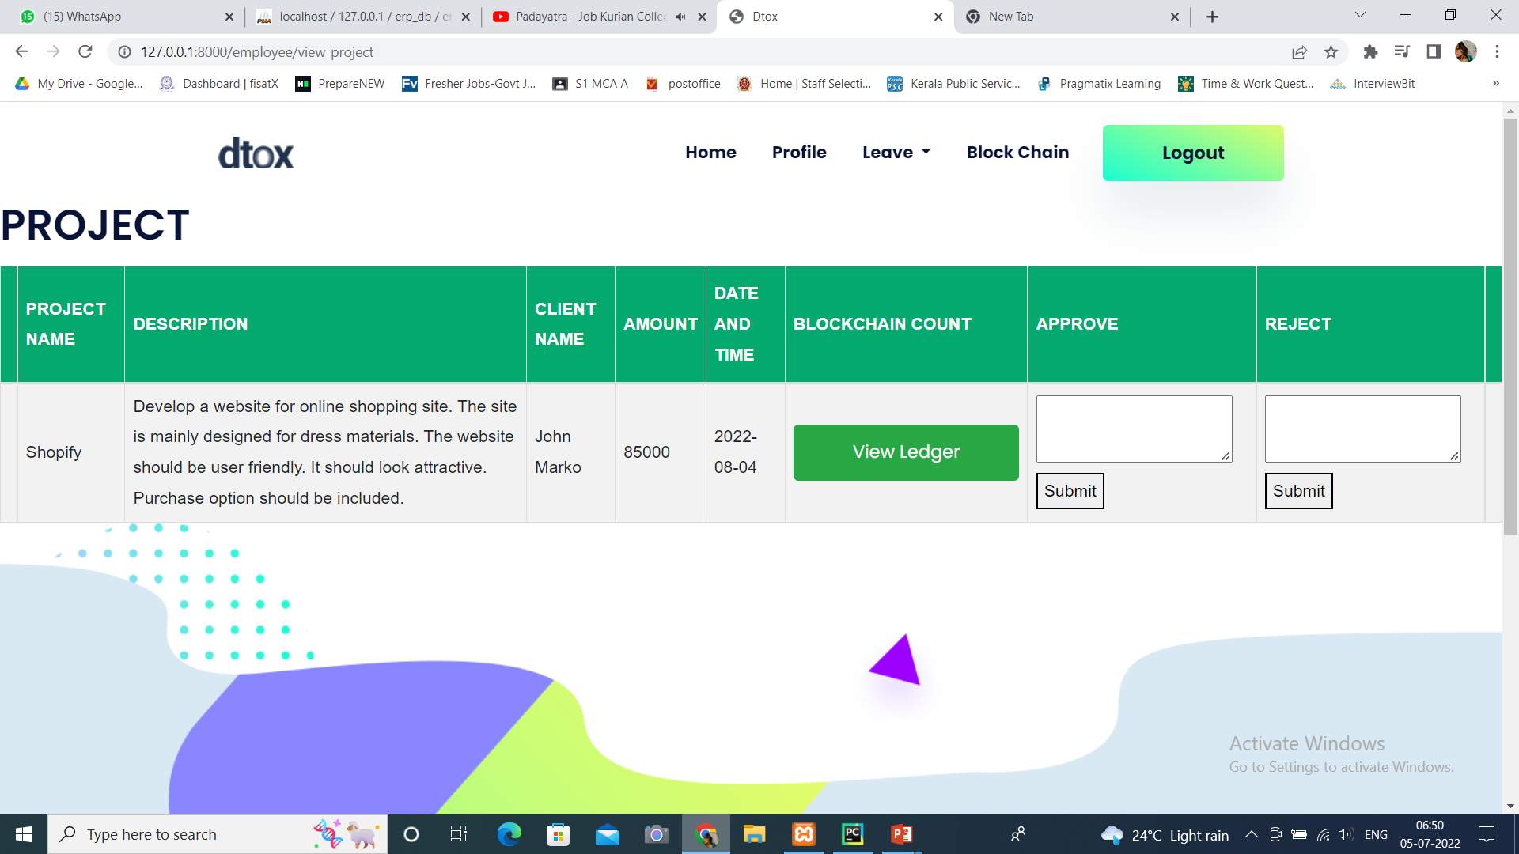
2. BLOCKCHAIN ADMIN
Approval

Slide 15
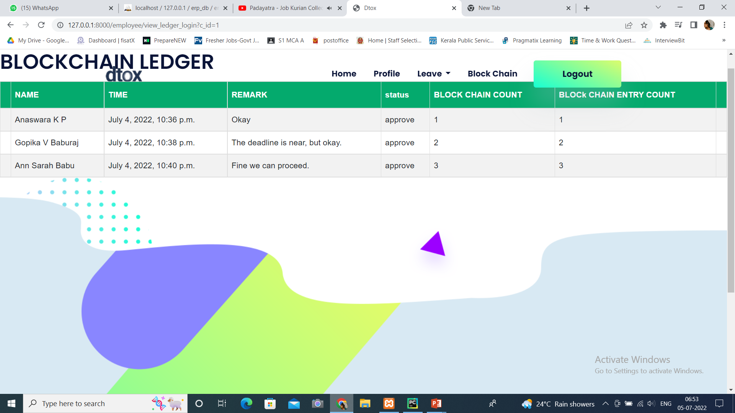
View Ledger

Slide 16
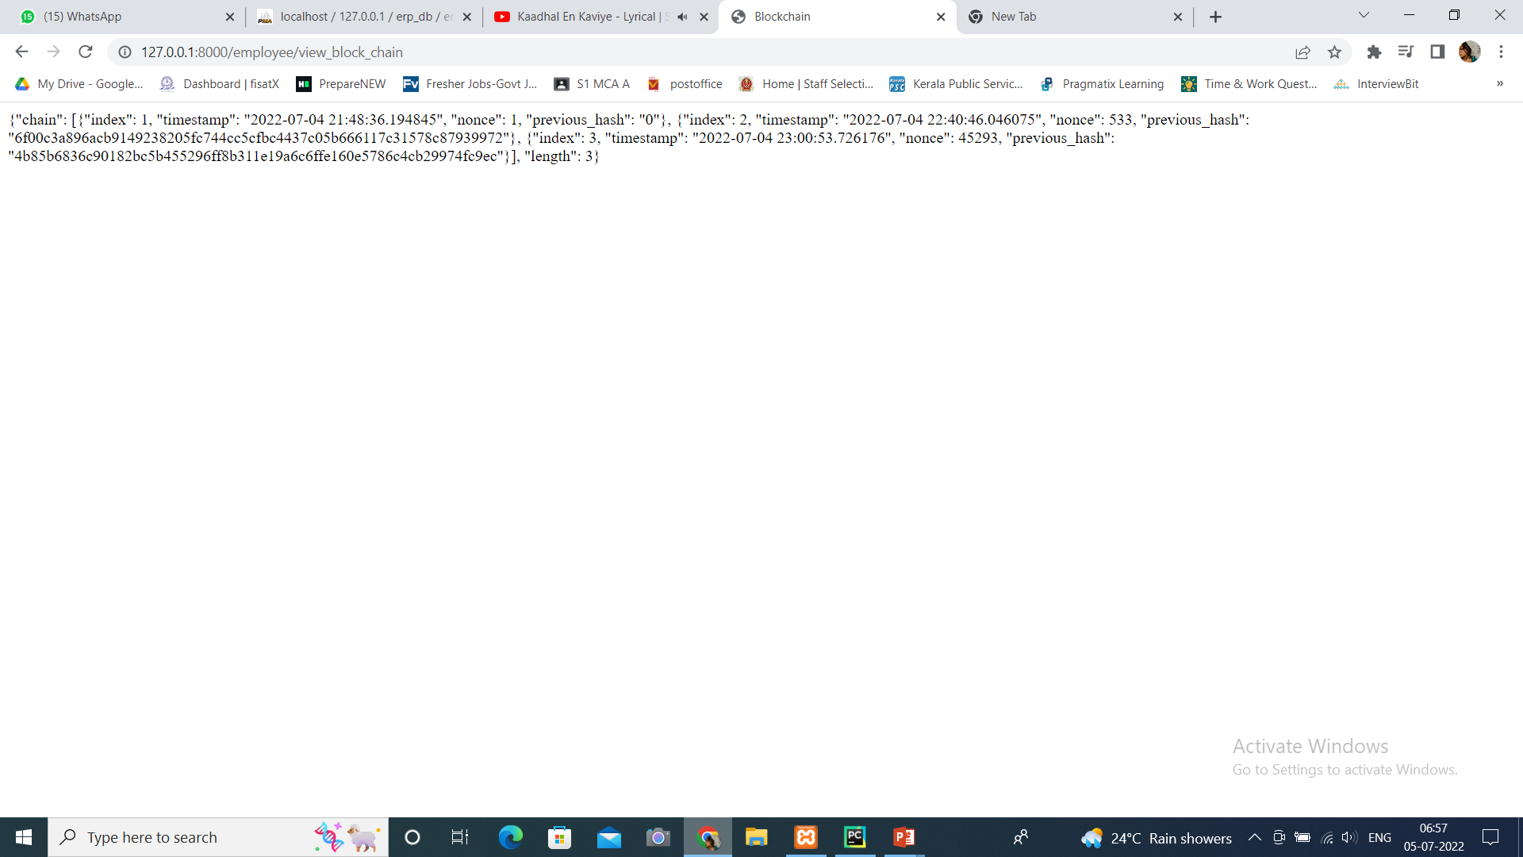
Blocks

Slide 17
THANK YOU

